Slide 1
Design and Implementation of a Neural Network based Controller on the Benchmark of Conical Tank Level System
Presented by
Sabarna Ghosh Dastidar

Slide 2
Contents
Introduction
Conical Tank Level System
Mathematical Modelling
Control Methodologies
Conventional PI Control Scheme
Proposed Neural Network Control Scheme
Results & Discussion
Servo Response
Regulatory Response
Parametric Uncertainty
Conclusion

Slide 3
Introduction
In the field of process industries, it became a very challenging problem to control the inlet flow of liquid and maintain a desired level of liquid at a constant value in a tank.
In this paper, the discussion has been done on the procedure of designing a controller for a conical tank-level system.
The modeling for a conical tank system is a little bit more complex than other linear tank systems (e.g. cubical, cylindrical, etc.) due to the change of its cross-sectional area from the bottom to top but it provides complete drainage as a result of it.
The feed-forward back-propagation neural network is used to implement the architecture of the controller and it is observed that the controller provides good results while performing the servo and regulatory response of the system.

Slide 4
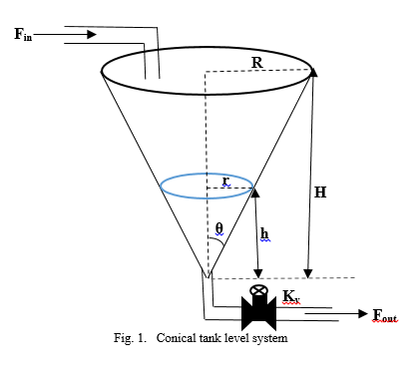
Conical Tank Level System
A conical tank level system is considered here for the research work because this is a highly nonlinear process with varying cross-sectional area where its area gets steeper towards the end for the guaranteed drainage of fluids in chemical industries.
Conical tanks find wide applications in process industries such as food processing industries, petrochemical industries, and sewage and wastewater treatment industries.

Slide 5
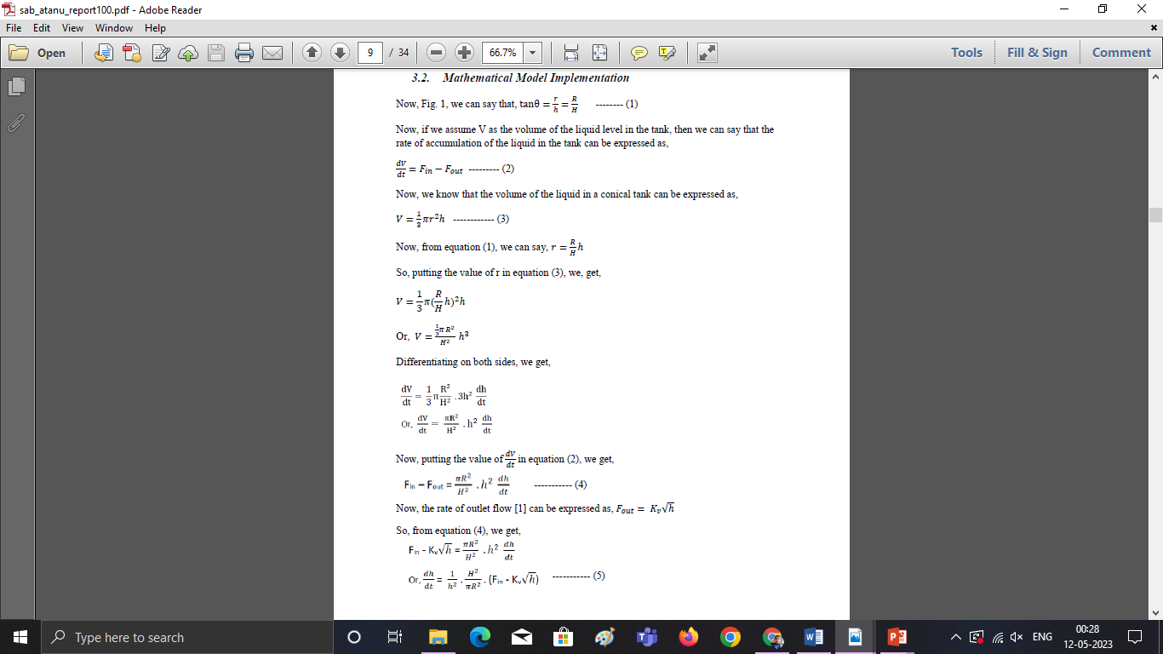
Mathematical Modelling

Slide 6
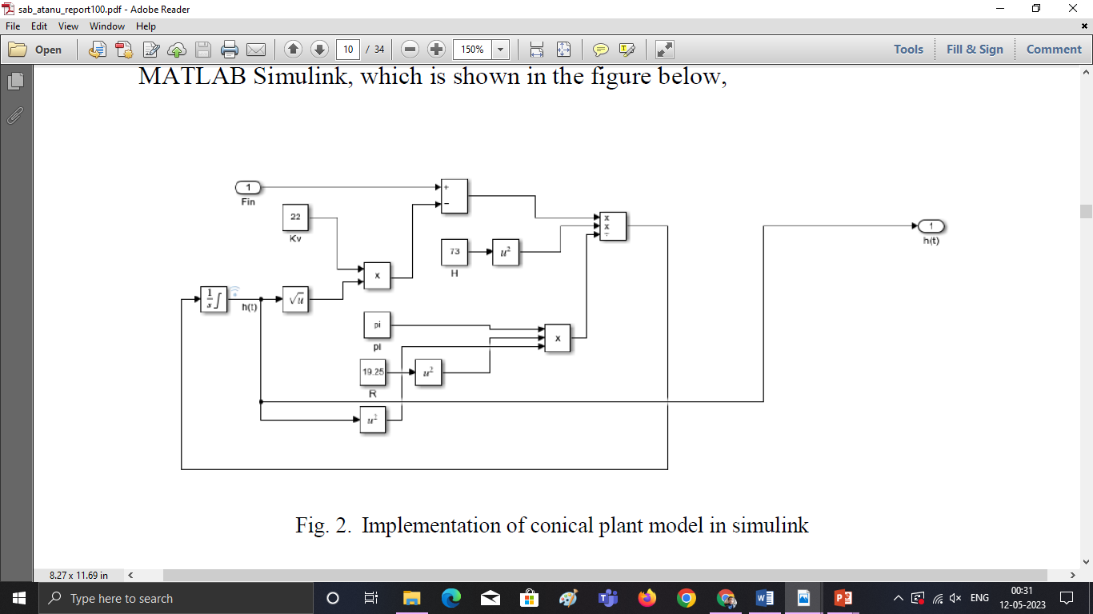

Slide 7
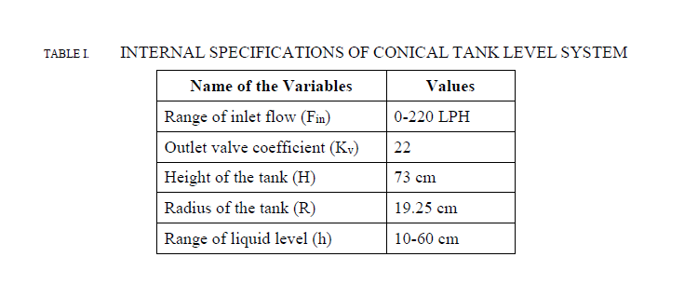

Slide 8
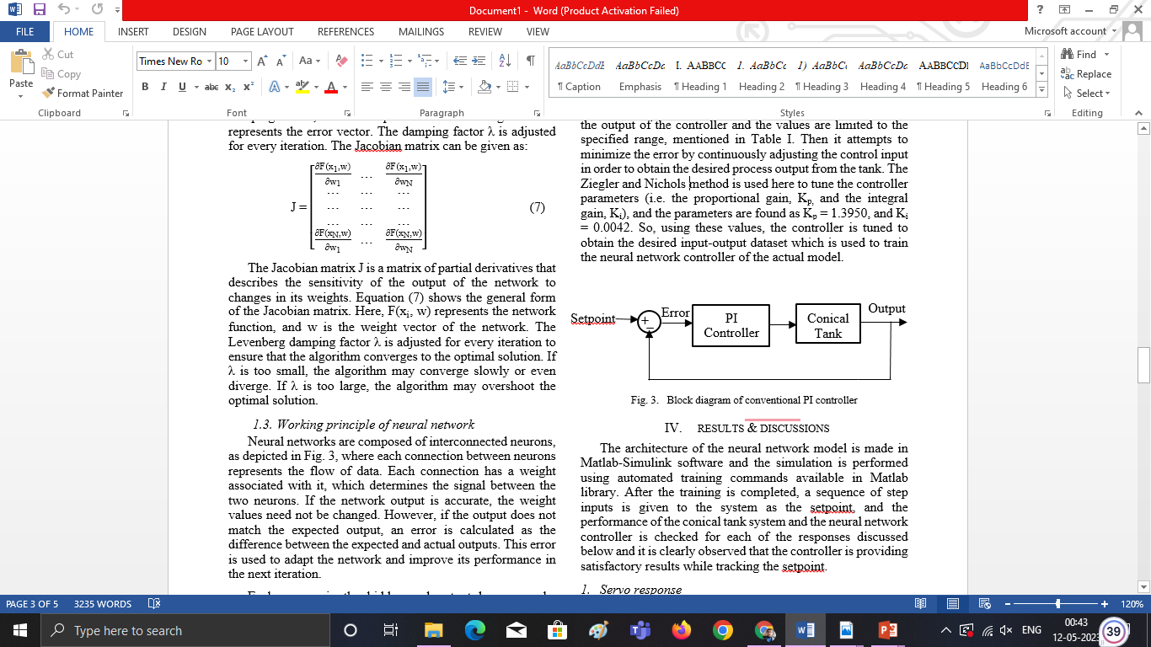
Conventional PI Control Scheme
The objective is to calculate an error value as the difference between a measured process variable and a desired set point. This error value is used as the input to the PI controller and the process input (i.e. the inlet flow of the liquid) is used as the output of the controller.
Ziegler and Nichols method is used here to tune the controller parameters (i.e. the proportional gain, K_{p,} and the integral gain, K_{i}), and the parameters are found as K_{p} = 1.3950, and K_{i} = 0.0042

Slide 9
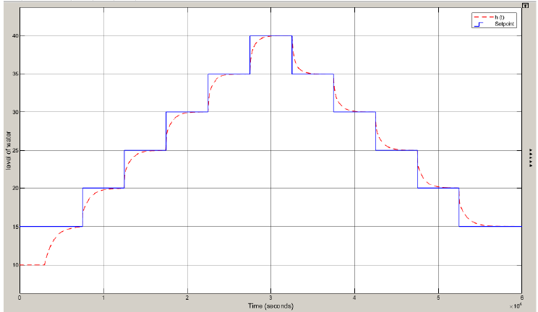
Reference Model Response

Slide 10
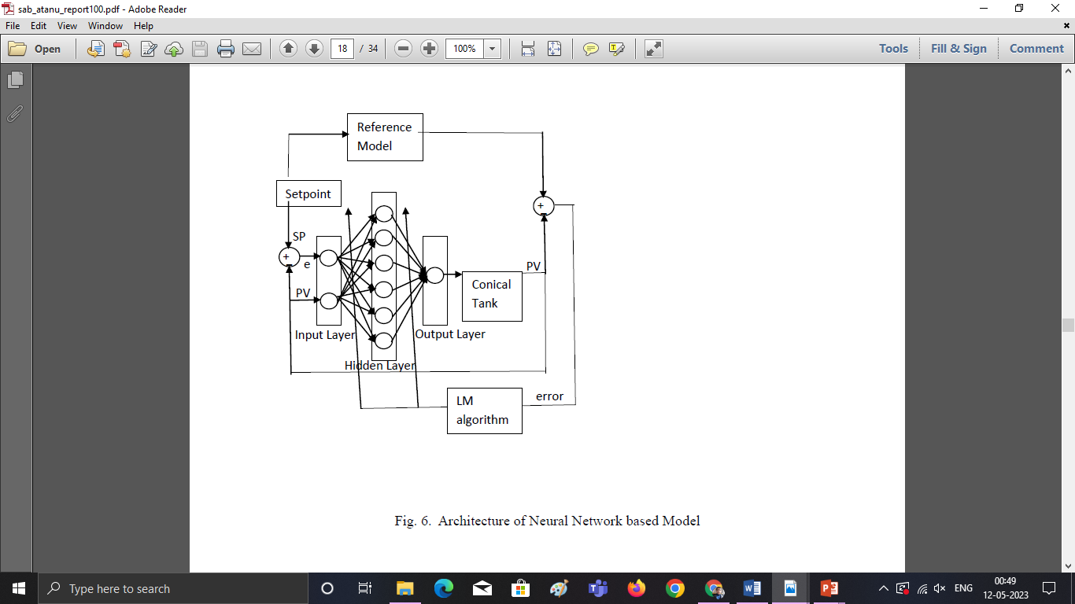
Proposed Neural Network Control Scheme

Slide 11
The neural network is an adaptive system that processes information using a connectionist approach. It consists of artificial neurons that are interconnected and its structure changes based on external or internal information that flows through the network during the learning phase.
The feed-forward back-propagation neural network is used as the network architecture here.
It consists of one input layer, one hidden layer, and one output layer. It processes information in a unidirectional manner, from the input layer through hidden layers to the output layer, without any cycles or loops
Two neurons are taken in the input layer and one neuron is taken in the output layer of the architecture. Using six neurons in the hidden layer, a better training result is observed. In the hidden layer, the hyperbolic tangent sigmoid transfer function (tansig) is used as the activation function and the linear transfer function (purelin) is used in the output layer.
The main concept of this architecture is to use a back-propagation algorithm (e.g. Levenberg-Marquardt) , which involves adjusting the weights of the neurons in each layer based on the difference between the actual output and the desired output.

Slide 12
Servo Response
Setpoint is set at 10 cm for the first 1000 seconds, then it is set at 47 cm for the next 2000 seconds and then it is set again at 23 cm for the next 2000 seconds and the output of the neural network model satisfactorily follows the setpoint.
The tracking response is shown in Fig. 9 and the controller output response is shown in Fig. 10. The variation of weights in the hidden layer is shown in Fig. 11.

Slide 13
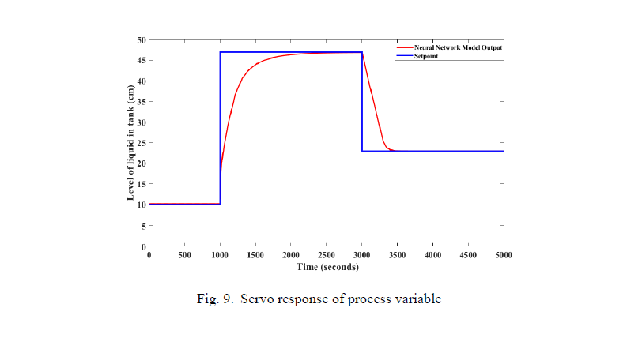

Slide 14
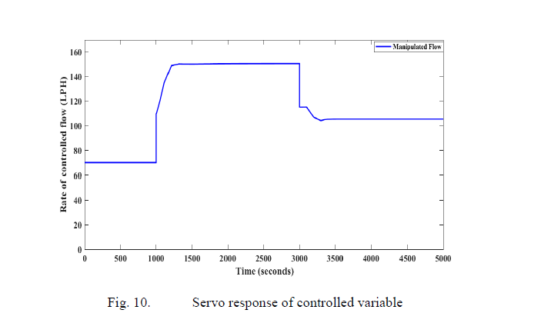

Slide 15
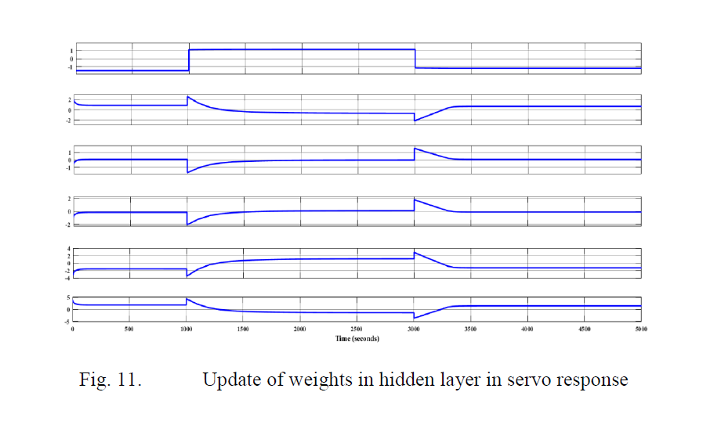

Slide 16
Regulatory Response
Setpoint is set at 10 cm for the first 100 seconds and then it is set at 27 cm for the total simulation time but during the simulation, at time, t = 2000 sec, a disturbance is added by reducing the flow by 20 LPH for a time duration of 60 seconds and at time, t = 3500 sec, another one disturbance is produced by increasing the flow by 20 LPH again for a time duration of 60 seconds.
It is clearly observed that the output of the neural network model satisfactorily handles the disturbance and follows the setpoint. The tracking response is shown in Fig. 13 and the controller output response is shown in Fig. 14. The variation of weights in the hidden layer is shown in Fig. 15.

Slide 17
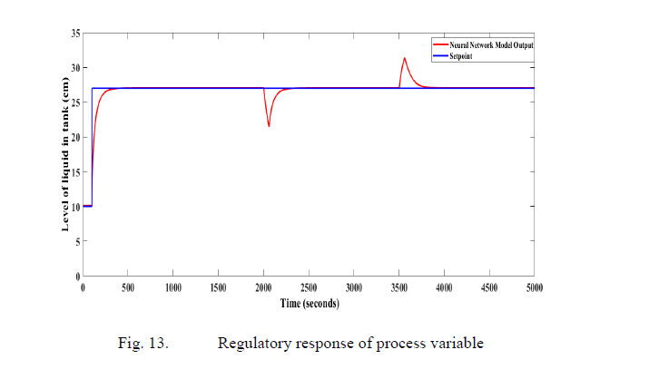

Slide 18
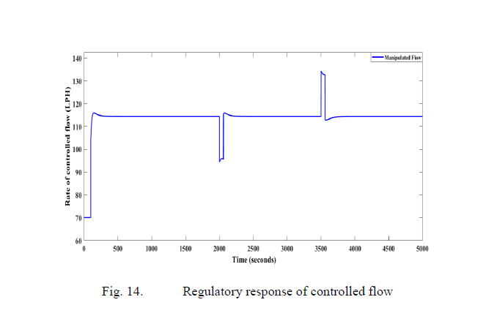

Slide 19
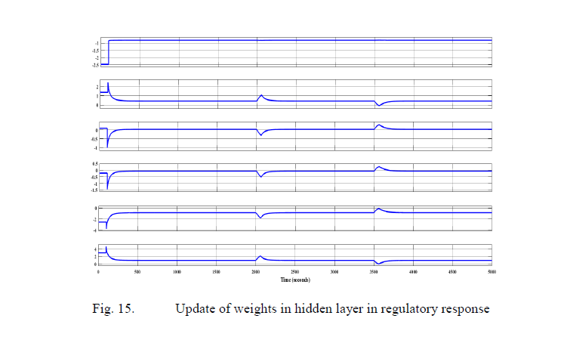

Slide 20
Parametric Uncertainty
Setpoint is set at 27 cm and two pulse disturbances are added at time, t =1500 sec and at time, t = 3500 sec respectively to vary the outlet valve coefficient Kv. The first one is having the amplitude = 4 and pulse width = 100 sec. The second one is having the amplitude = -4 and pulse width = 100 sec.
It is clearly observed that the output of the neural network model satisfactorily handles the disturbance and follows the setpoint.
The variation of Kv is shown in Fig. 16. The tracking response is shown in Fig. 17 and the controller output response is shown in Fig. 18. The variation of weights in the hidden layer is shown in Fig. 19.

Slide 21
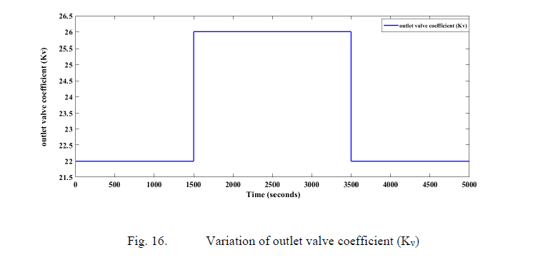

Slide 22
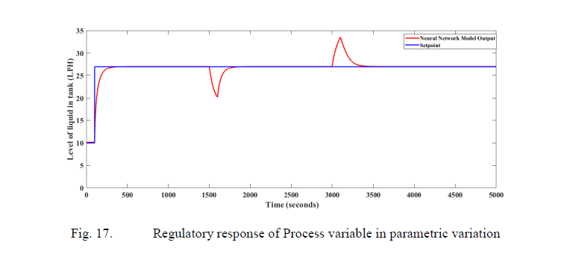

Slide 23
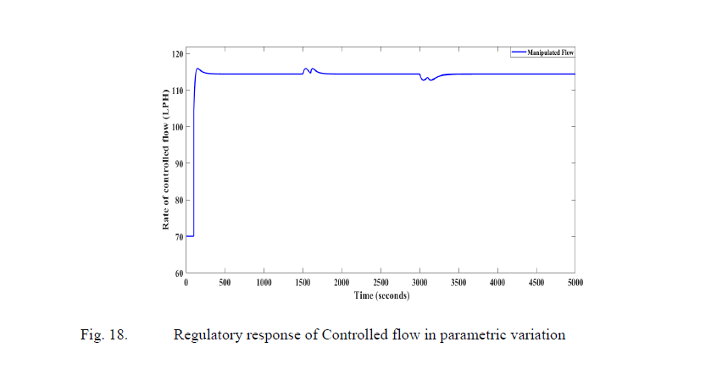

Slide 24
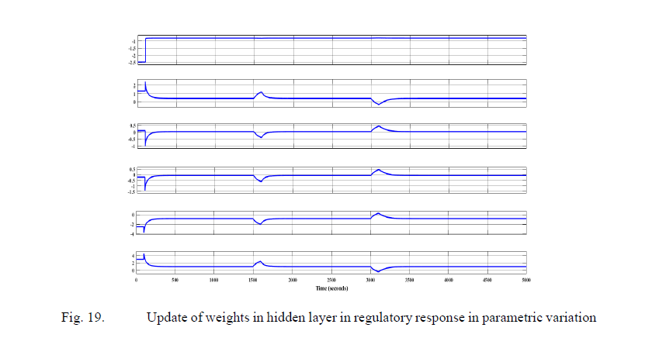

Slide 25
Conclusion
This paper presents a case study on the application of an adaptive neural network control scheme to regulate the liquid level in a nonlinear tank-level system.
The simulation results demonstrate that the controller achieves the desired performance for both the servo and regulatory response of the conical tank level system.
These findings are valuable for the field of process control industries, as they demonstrate the potential for effective control of liquid levels in nonlinear tank systems.

